Slide 1

CSC349 User Experience
Practical 1 – Basic Concept Sketching

Slide 2

Practical Overview
In lectures we have talked about the idea of sketching – we are now going to move on to start playing with that idea more. You will cover:
Basic sketching, reduction, elaboration and variation (individual then group)
Real world sketches of interesting interfaces (individual)
Capturing what you actually see (individual)
Screen design processes (group)
Capturing the real world (individual)
Coffee break (remember this when you fill in your NSS!)
After this we will move on to start to address a real world problem (group)
Multiple techniques you can implement suggested (group)
Finally groups present their ideas

Slide 3
Design challenge 1:
Connecting Two Smart Phones
Mobile phones can connect to other phones and devices in their environment but this typically involves convoluted dialogue options. For this exercise, sketch 10 novel ways that two people can connect their devices together that do not involve these painful dialogues.
Assumptions
Mobiles detect other devices nearby and can communicate
You and the person nearby can both perform some sort of handshake

Slide 4
Design challenge 1:
Reducing the number of concepts
Try top look for common themes across the sketches that you have produced
Look at another person work and talk about it
At this point, if you like, you can produce other sketches based on the ideas that you have produced so far
Notes:
Then what happens? We have a raft of issues to address
three's no clear cut law of emergence vs. convergence

Slide 5
Design challenge 1:
Selection and elaboration
Chose the most promising design concept as a staring point
Produce 10 details and/or variations of that particular design concept
Detail what exactly the people involved have to do
Try out slight variations on your concepts
Don’t limit your thinking yet
Remember, your designs are to evoke or guide an experience with the device, what is that experience going to be?

Slide 6
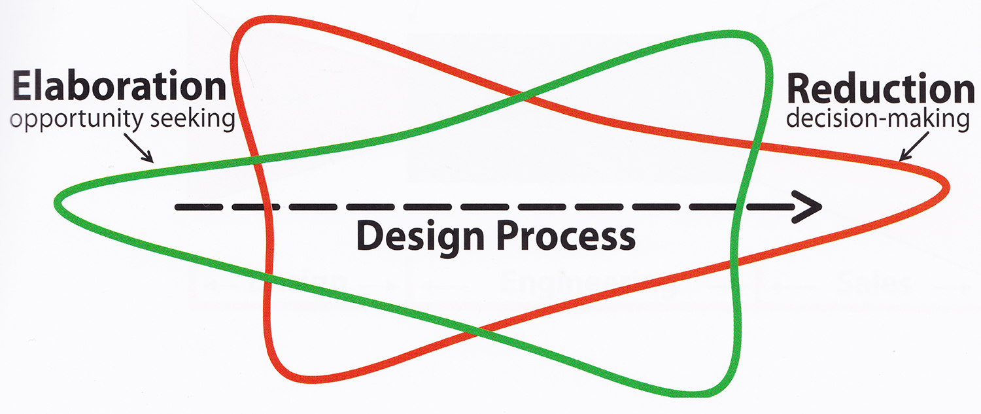
The design funnel
Notes:
Then what happens? We have a raft of issues to address
three's no clear cut law of emergence vs. convergence

Slide 7
Design challenge 2:
Sketching the real world
Look at the following interface and quickly (30 seconds) capture the interface in a sketch
Ready, set, go!
Notes:
Then what happens? We have a raft of issues to address
three's no clear cut law of emergence vs. convergence

Slide 8
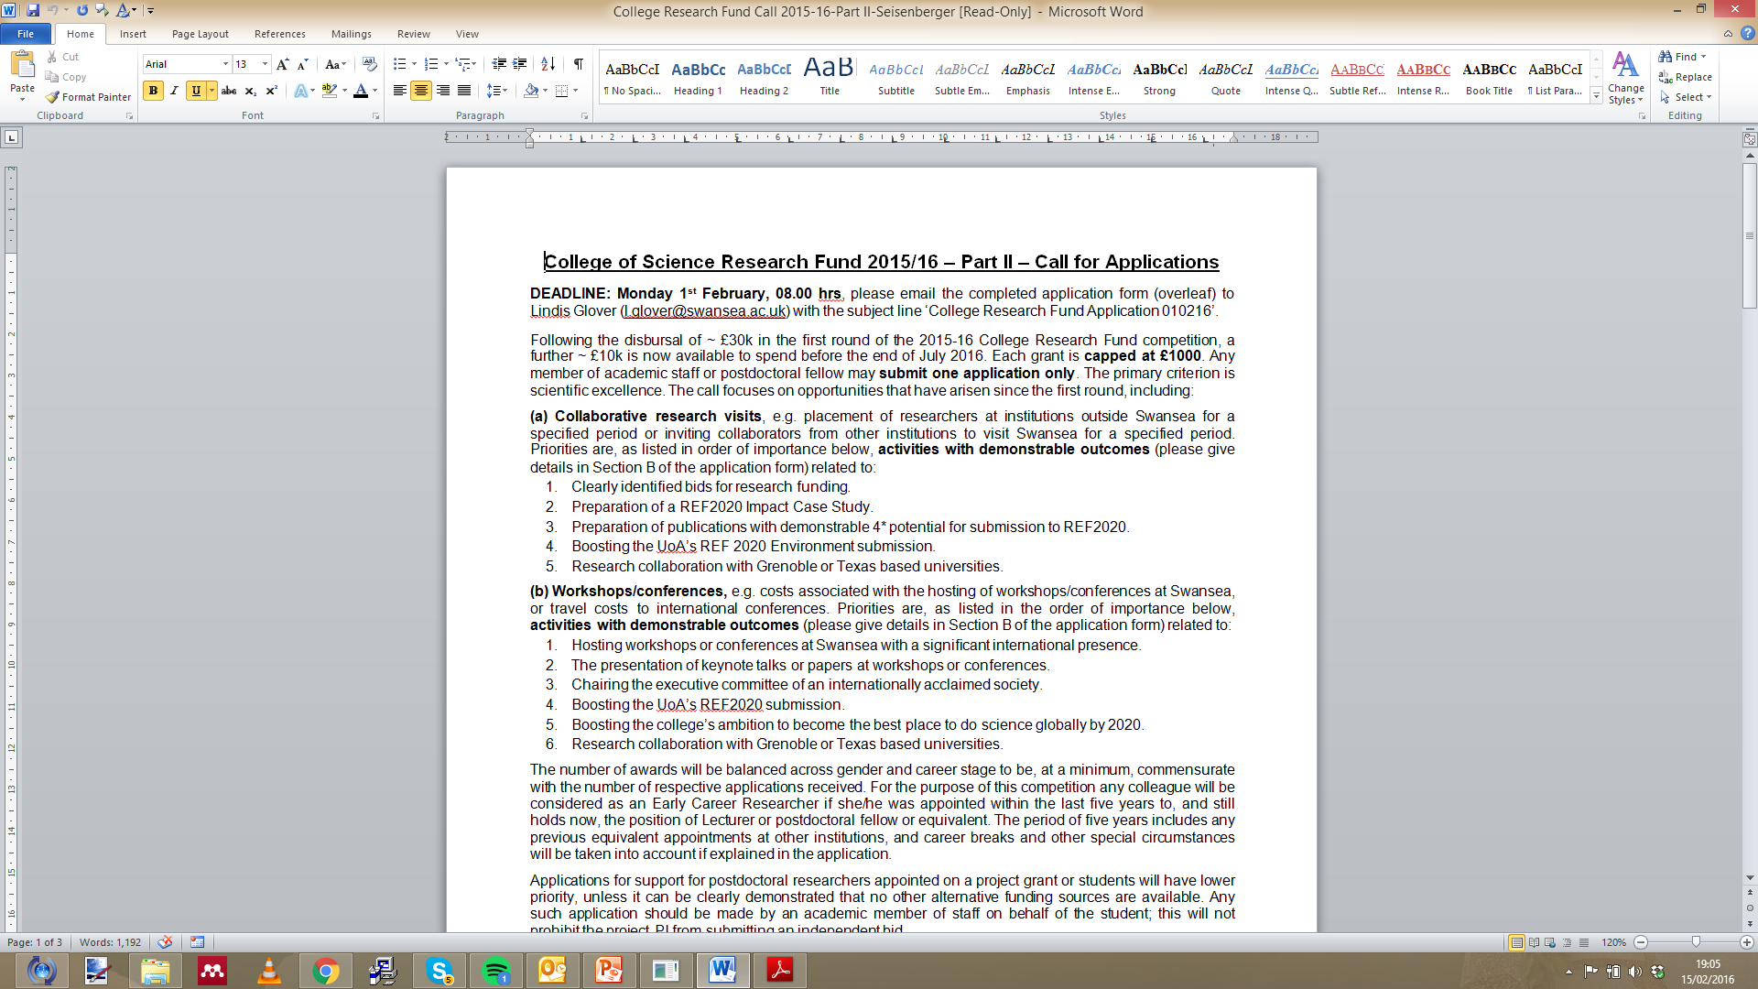

Slide 9
Design challenge 2:
Sketching the real world
Look at the sketch you made and compare it to the interface…
Did you finish it in time?
Did you capture the most important details?
Notes:
Then what happens? We have a raft of issues to address
three's no clear cut law of emergence vs. convergence

Slide 10
Design challenge 2:
Sketching the real world
Look at the sketch you made and compare it to the interface…
Did you finish it in time?
Did you capture the most important details?
Now, do the same thing but use an interface that you are familiar with on your mobile phone or on a laptop.
Notes:
Then what happens? We have a raft of issues to address
three's no clear cut law of emergence vs. convergence

Slide 11
Design challenge 2:
Sketching the real world
Look at the sketch you made and compare it to the interface…
Did you finish it in time?
Did you capture the most important details?
Now, do the same thing but use an interface that you are familiar with on your mobile phone or on a laptop.
Did you finish it in time?
Did you capture the most important details?
Notes:
Then what happens? We have a raft of issues to address
three's no clear cut law of emergence vs. convergence

Slide 12
Design challenge 2:
Sketching the real world
Now, swap screens with someone who has an unfamiliar interface to you and get ready to repeat the exercise for a third and final time.
This time you are not allowed to look at the paper as you are capturing the sketch.
Notes:
Then what happens? We have a raft of issues to address
three's no clear cut law of emergence vs. convergence

Slide 13
Design challenge 2:
Sketching the real world
Now, swap screens with someone who has an unfamiliar interface to you and get ready to repeat the exercise for a third and final time.
This time you are not allowed to look at the paper as you are capturing the sketch.
Did you finish it in time?
Did you capture the most important details?
Can you understand the sketch still?
Notes:
Then what happens? We have a raft of issues to address
three's no clear cut law of emergence vs. convergence

Slide 14
Design challenge 3:
Capturing what you actually see
Sketch out a realistic picture of a face (30 seconds).
Notes:
Then what happens? We have a raft of issues to address
three's no clear cut law of emergence vs. convergence

Slide 15
Design challenge 3:
Capturing what you actually see
Sketch out a realistic picture of a face (30 seconds).
How do the proportions look?
How high are the eyes?
Did you draw a real face
Notes:
Then what happens? We have a raft of issues to address
three's no clear cut law of emergence vs. convergence

Slide 16
Design challenge 3:
Capturing what you actually see
Draw a sketch of a person (2 minutes)
Notes:
Then what happens? We have a raft of issues to address
three's no clear cut law of emergence vs. convergence

Slide 17
Design challenge 3:
Capturing what you actually see
Copy the sketch from the following slide (2 minutes)
Notes:
Then what happens? We have a raft of issues to address
three's no clear cut law of emergence vs. convergence

Slide 18
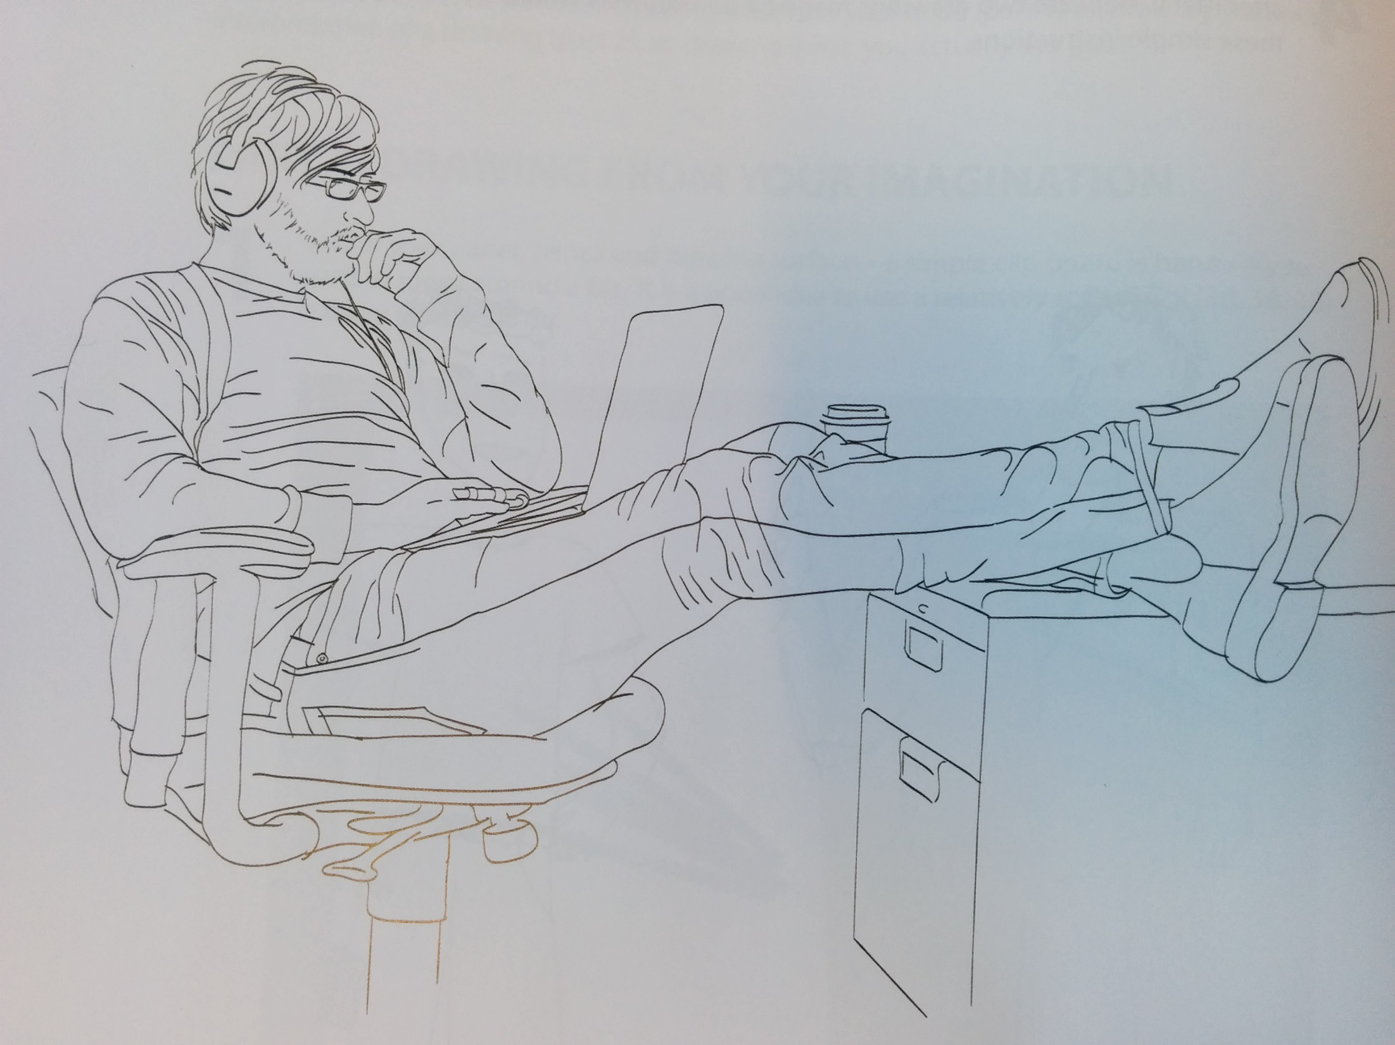

Slide 19
Design challenge 3:
Capturing what you actually see
Turning the sketch upside down, now focus on the lines rather than trying to draw the object completely (2 minutes)
Notes:
Then what happens? We have a raft of issues to address
three's no clear cut law of emergence vs. convergence

Slide 21
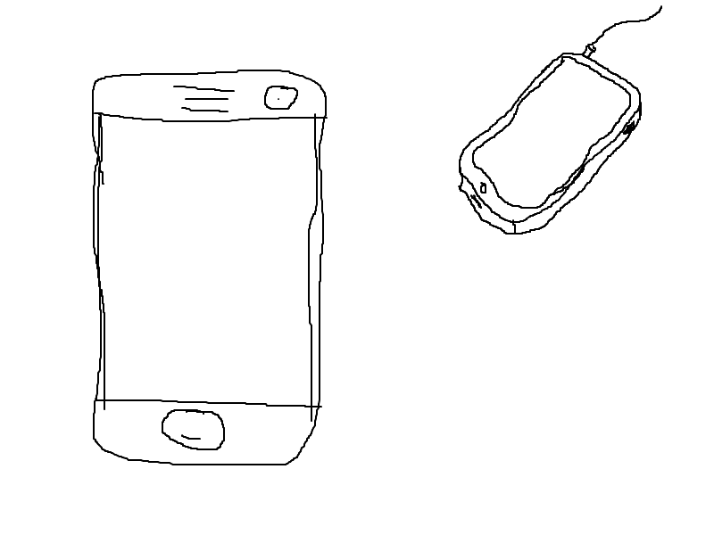
Design challenge 4:
Mobile screen design
Producing a mobile interface sketch is straightforward
Literally even I can do it
The trick here is to think about how you can capture interactions with them and transitions?
This is a core challenge in design
In groups, trial 3 ways to capture
use of a mobile device screens
Notes:
Then what happens? We have a raft of issues to address
three's no clear cut law of emergence vs. convergence

Slide 22
Design challenge 4:
Mobile screen design
In groups, trial 3 ways to capture use of a mobile device screens
Hints:
What are you drawing?
The people around you?
Comic books?
Notes:
Then what happens? We have a raft of issues to address
three's no clear cut law of emergence vs. convergence

Slide 23
Design challenge 5:
Capturing the real world
Time to try something different
While you are out taking a break pay attention to the world around you, look for things that you can interact with that are interesting or poorly designed
Use your smartphone to capture images
(try to get at least 5)

Slide 24
Group challenge
You will be working your groups of 5 for this task.
I would recommend starting out by sketching out designs individually like you did in the first exercise but where do you go from there?
Share and improve individually?
Design crits?
Card sorting?
Interface design?
Key challenge – how are you going to present your ideas at the end of the session?

Slide 25
Group challenge – coordinating design work
Design crits – everyone presents their ideas and gets constructive feedback (no-one cries)
Group Brainstorming – throw out as many ideas as possible
Workshopping – discussion and creation of shared sketches
One thing I like/One thing I loathe – post-it note critique of ideas

